Slide 1
Appliances for domestic biogas plants
Biogas compact course
PPRE- Oldenburg University
April 26 28, 2011

Slide 2
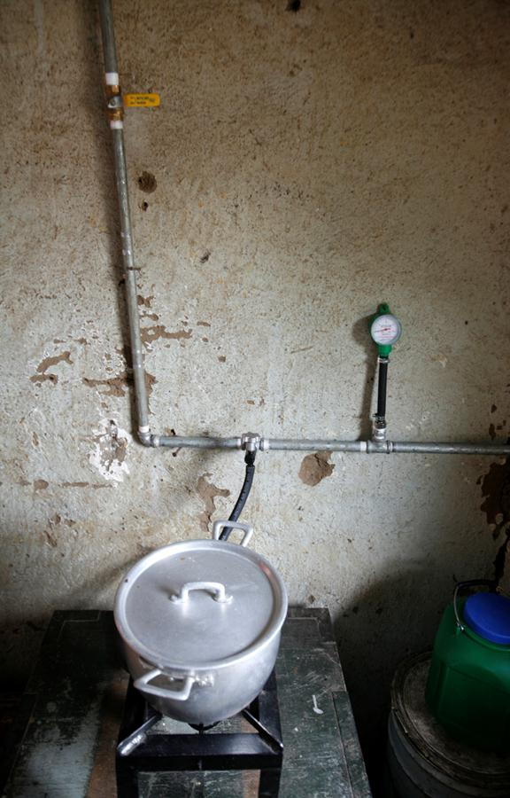

Slide 3
Presentation Planning
Household gas use
Combustion process
Stoves design criteria
Lamps
Importance of appliances
Refer to the reader

Slide 4
Household gas use
The average household biodigester is not suitable to run a electricity generator
Biogas cannot be bottled
It is an excellent energy source for cooking and lighting which accounts for more than 95% of rural domestic energy use

Slide 5
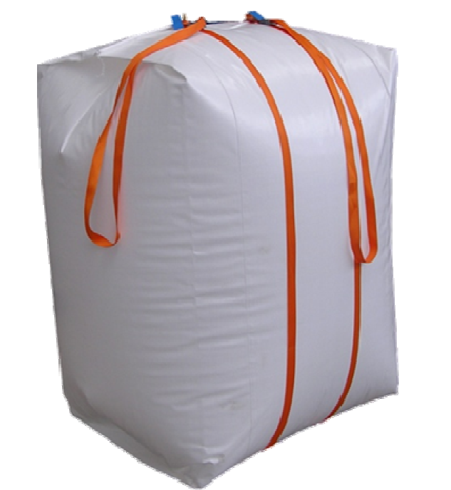
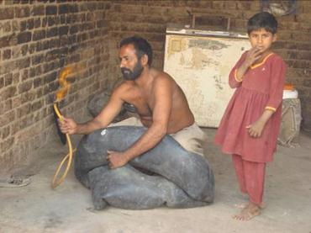
“Bottling biogas”

Slide 6
Advantages of biogas for cooking
CONVENIENCE
  time-saving; wood collection and cleaning: Vietnam 1,5 to Nepal 6 h/d
  cooking faster; flame can be regulated;
  cooking can be done in up-right position;
  cooking can be easily done inside the house;
FINANCE
  Saves money on energy sources
HEALTH
  fine particles and CO: smoke world death-cause nr. 3 AIDS Malaria; 1.6 mln death per year
  safer, less chance for accidences like with open fire

Slide 7
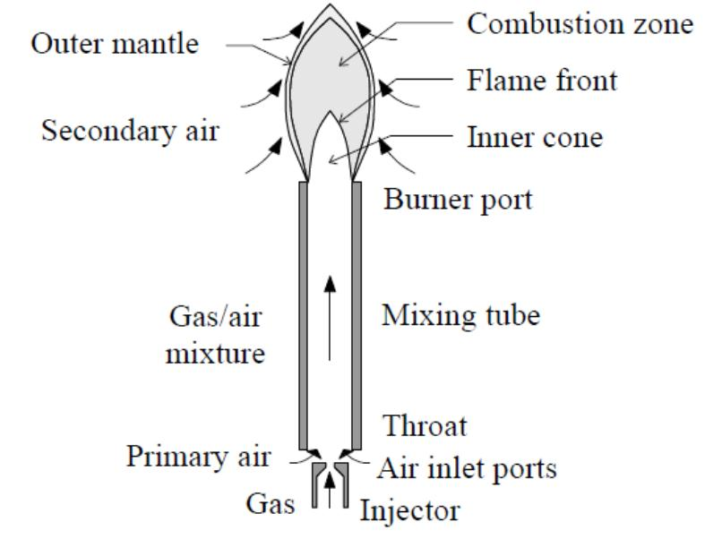
Combustion process during cooking

Slide 8
Combustion process during cooking
Primary air intake ~ 90%, secondary air 10%
5.7 volume air is required for 1 volume biogas for complete combustion
Mix too rich: incomplete combustion, CO emission, less efficiency
Mix too lean: too much air cools the flame, less efficiency
Combustion speed 40cm/sec

Slide 9
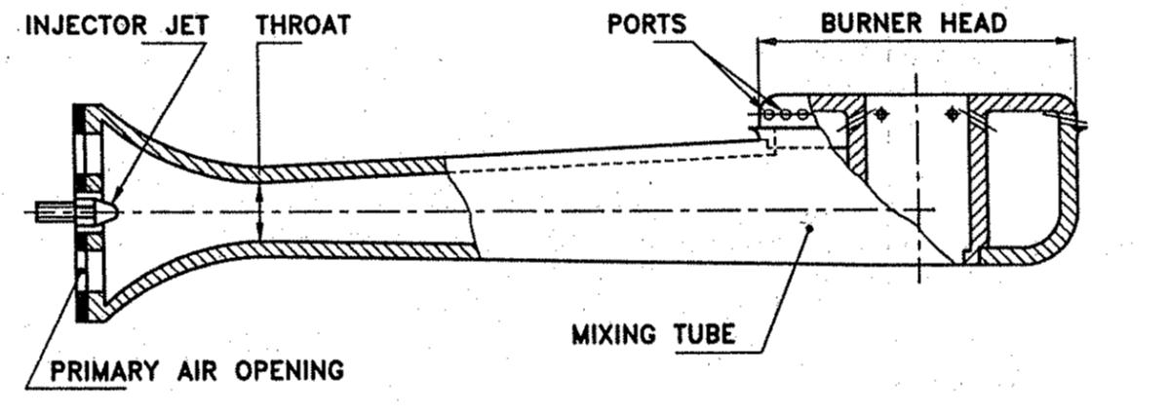
Stove design

Slide 10
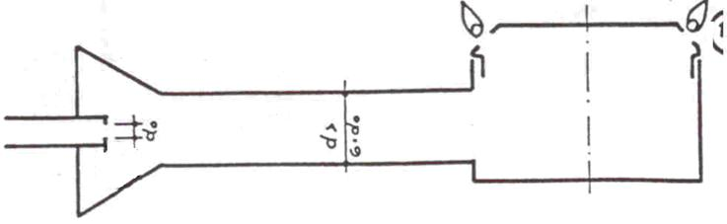
Stove design
Burner design criteria:
Starting values:
QR [kcal/h] = prescribed heat requirement
VF [m3/h] = fuel flow rate
H [m W.C.] = prescribed gas pressure
Geometrical data:
do [mm] = 2.1 * √(VF/√h) (jet diameter)
d [mm] = 6 * do (diameter mixing pipe)
l [mm] = 7 * d (length of mixing)

Slide 11
Stove design considerations
Efficiency > 55%
User comfort (position of the tap, gas flow regulation capacity of the tap, primary air intake regulation)
Stability of the frame, distance burner – frame support
Stability of the cooking vessel on the pan supports
Distance bottom cooking vessel – flame ports burner, 25 – 30 mm
CO emissions
Manufacturing simplicity, locally made preferably by various rural workshops
Cost

Slide 12
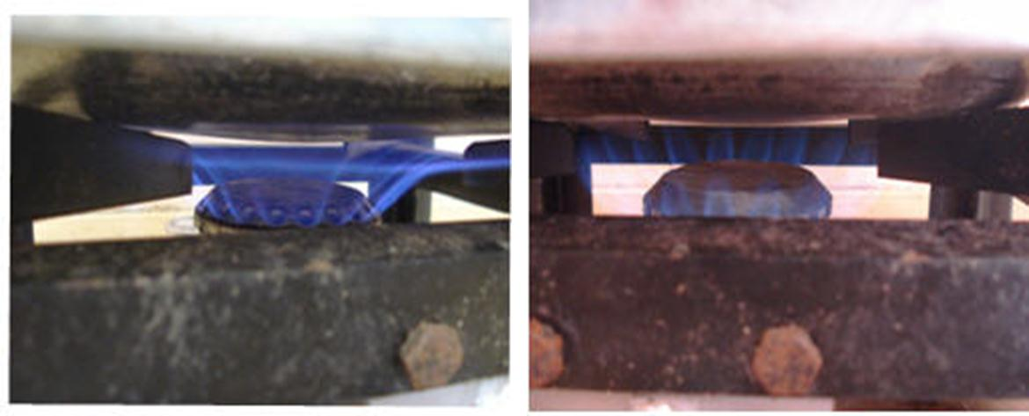

Slide 13
Stove test results
Name | Burner | Pan height | CO PPM | Flue temp | Time to Boil (mins)
Test 1 | standard | 32 mm | 251 | 84 | 4.9
Test 2 | lotus | 32 mm | 203 | 87 | 5.0
Test 3 | lotus | 39 mm | 32 | 89 | 5.2
Test 4 | standard | 39 mm | 286 | 82 | 4.8

Slide 15
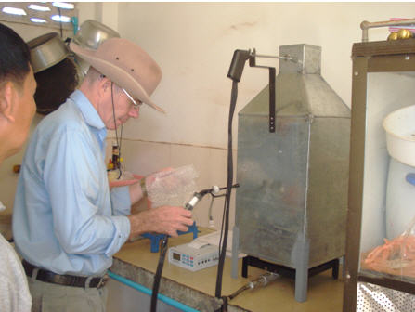
Stove testing under basic lab conditions
Flue
John
Gas and temperature sensor
Filter
Meter
Stove

Slide 16
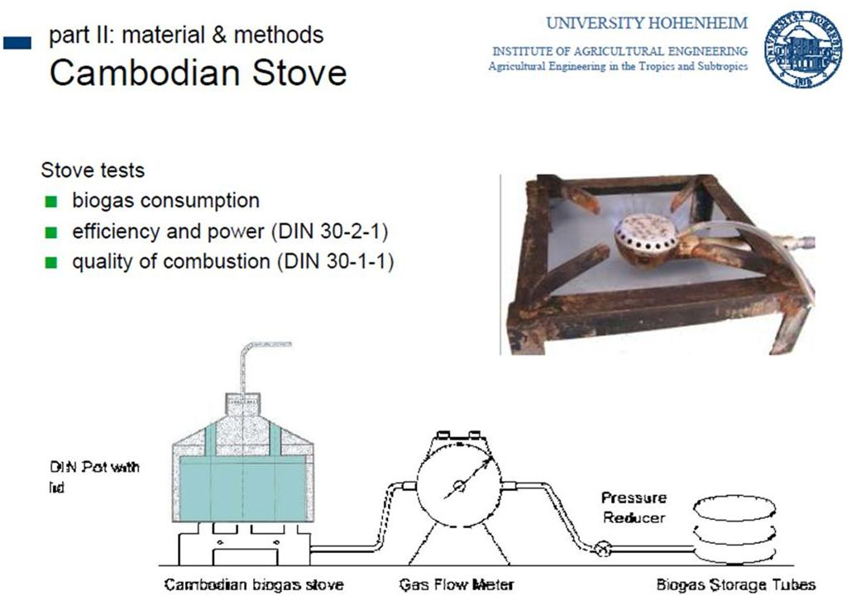
More stove tests

Slide 17
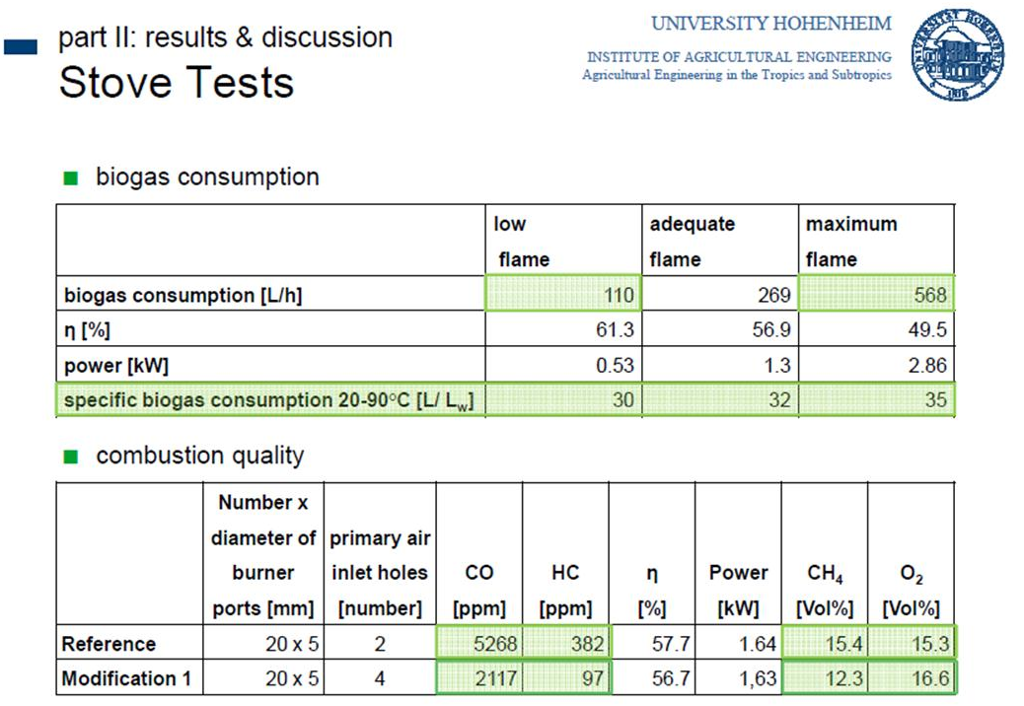
And some stunning results …

Slide 18
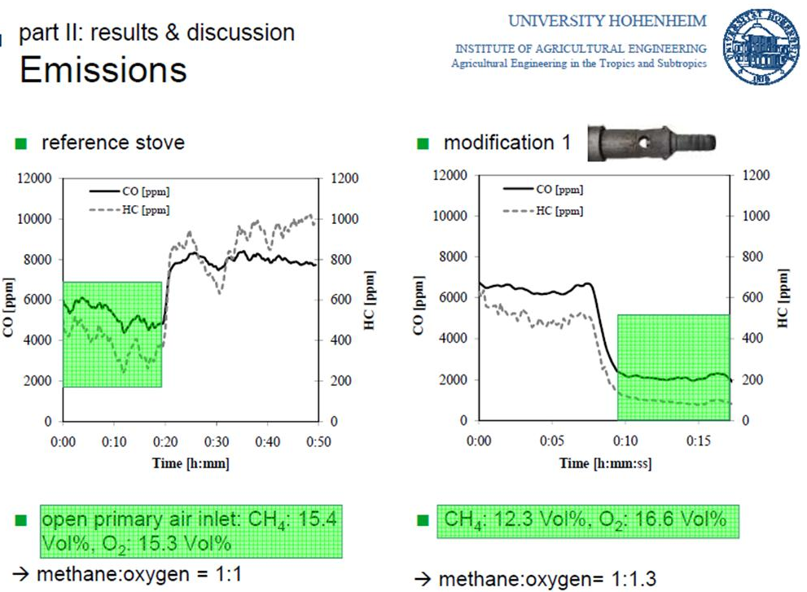

Slide 19
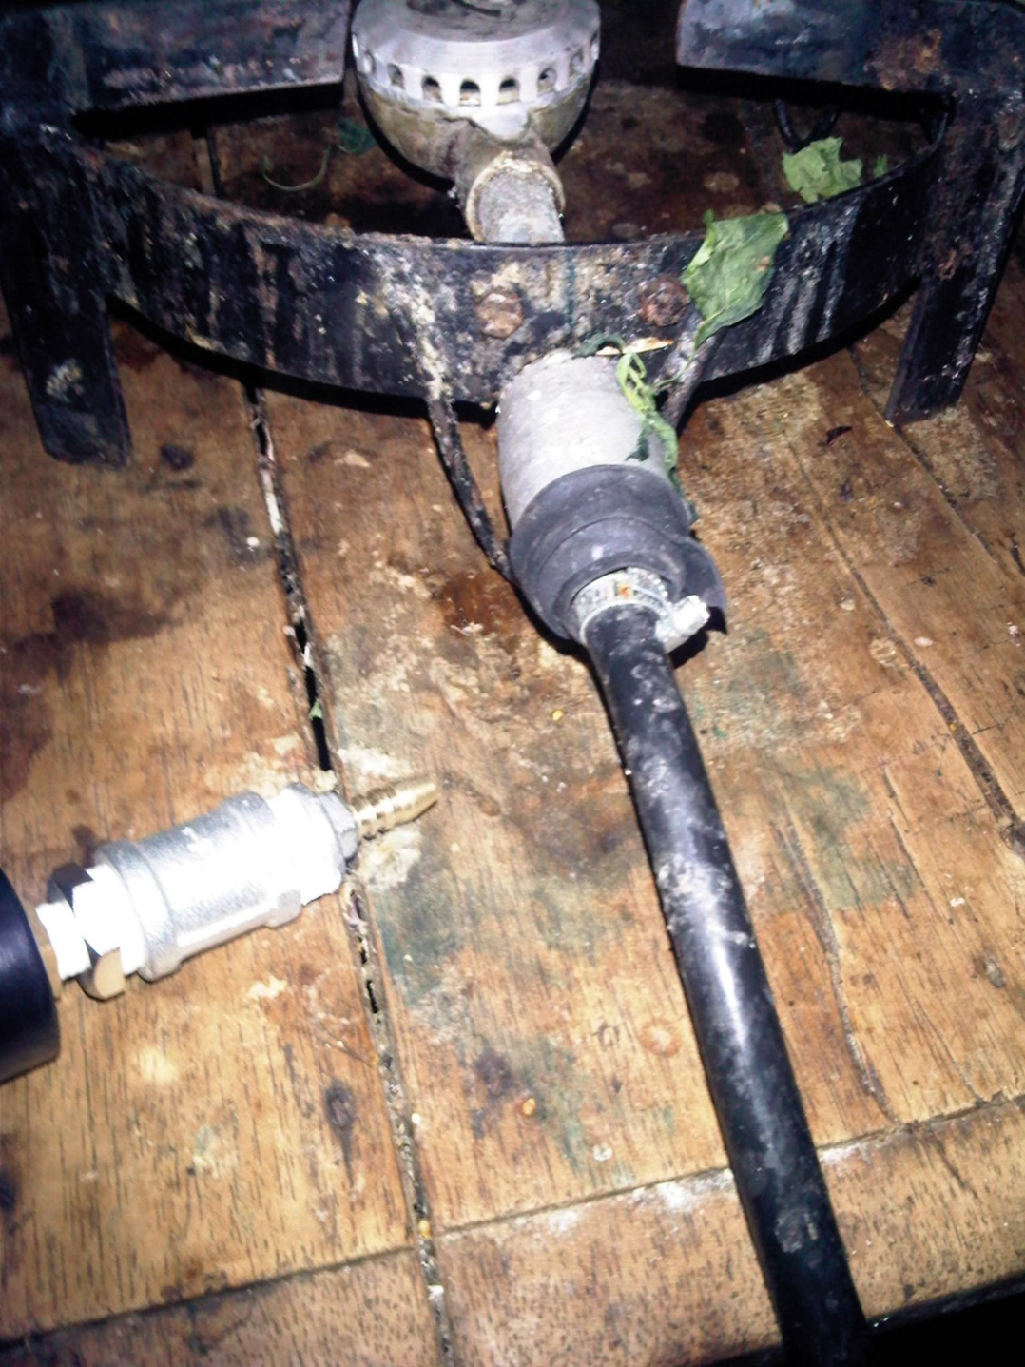
And a shroud is not solving the problems …

Slide 20
Biogas stove standards
..\..\2010 Quality Management\03 QS Appliances\QS Appliances Text files\Biogas Stove Part 1.doc

Slide 21
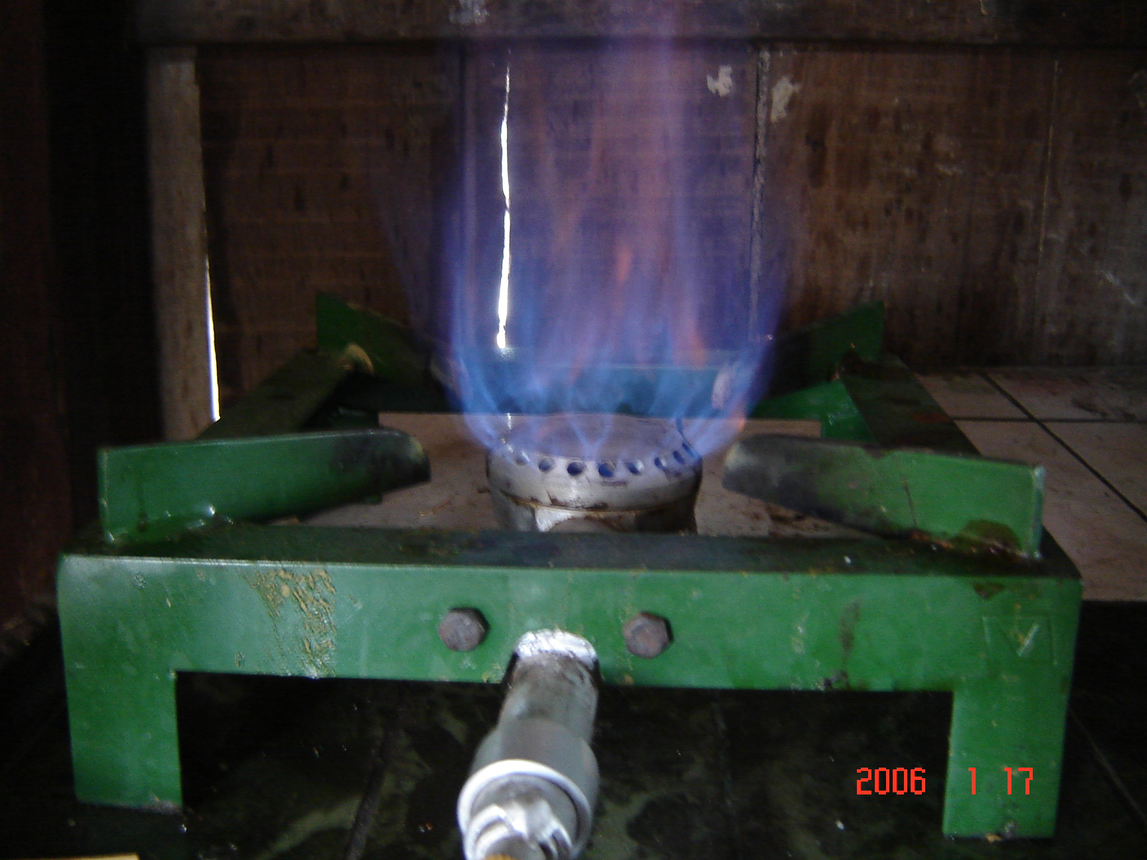

Slide 22
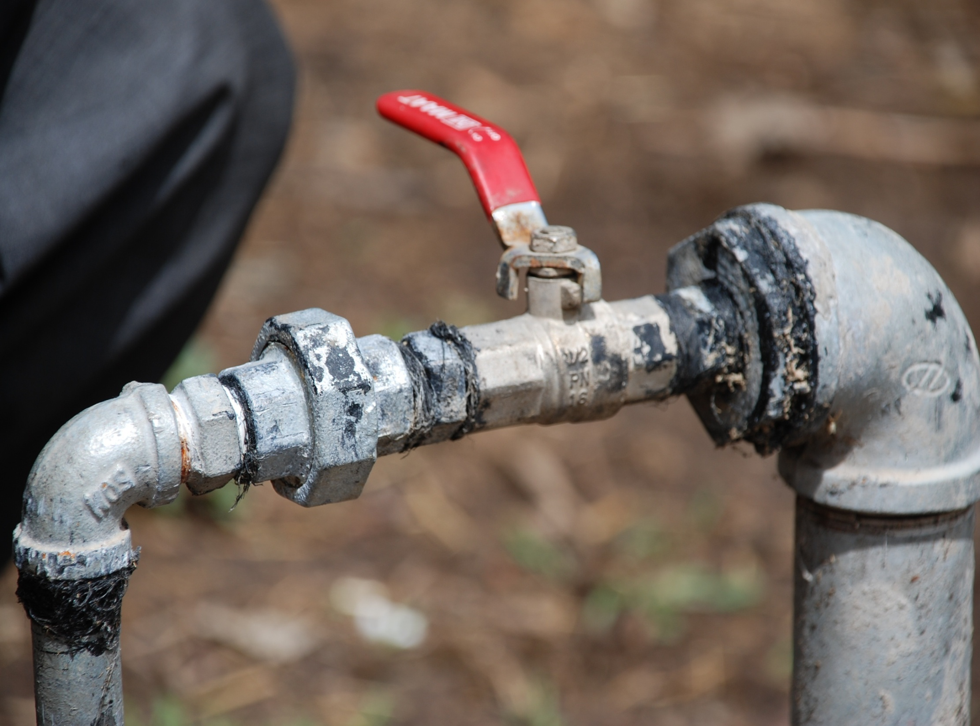
Quality Quotes
Good is not good where better is expected." -- Thomas Fuller
The bitterness of poor quality lingers long after the sweetness of low price.
If you think training is expensive...consider ignorance. – Anonymous

Slide 23
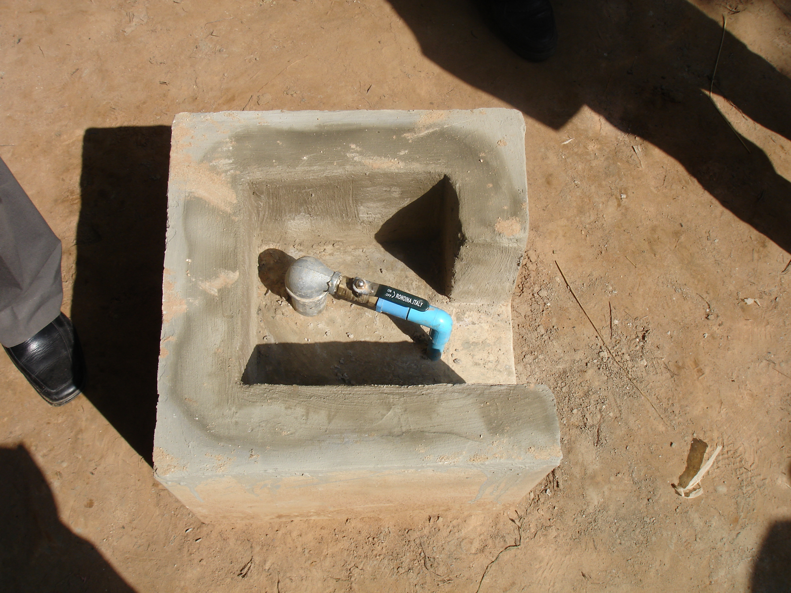

Slide 24
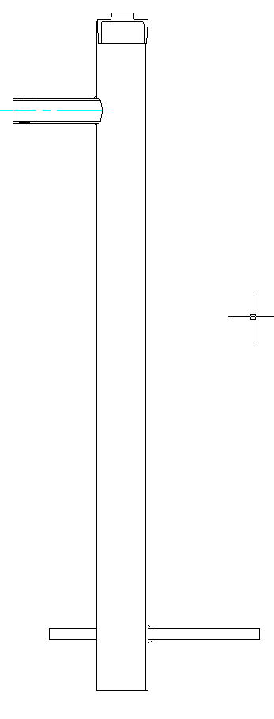
Dome Gas Pipe

Slide 25
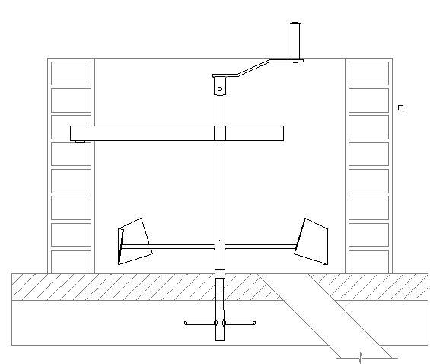
Mixer

Slide 26
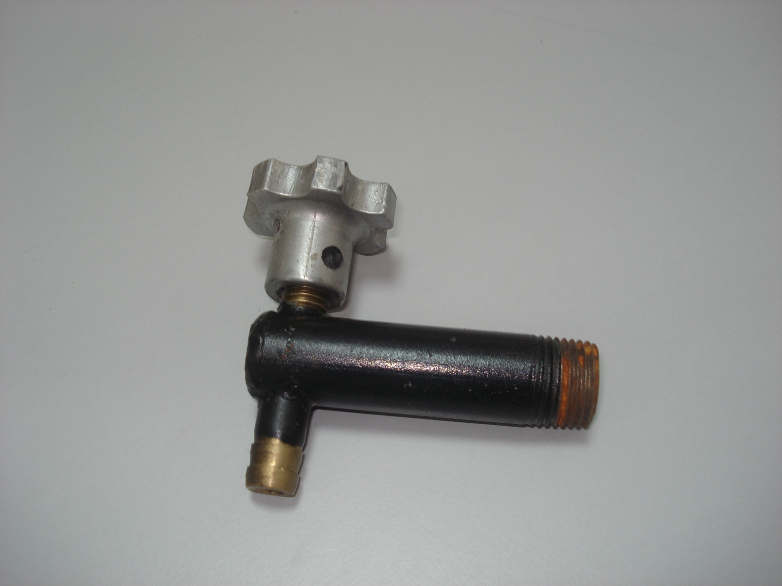
Gas tap

Slide 27
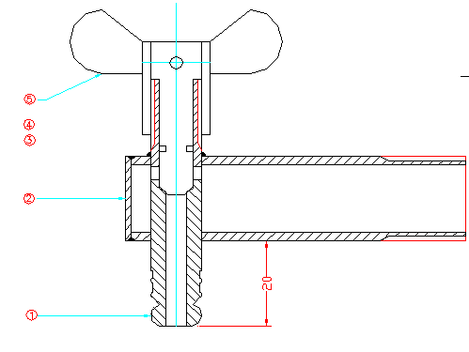
Gas Tap

Slide 28
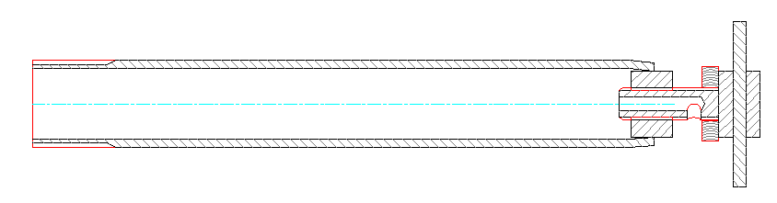
Water Drain

Slide 29
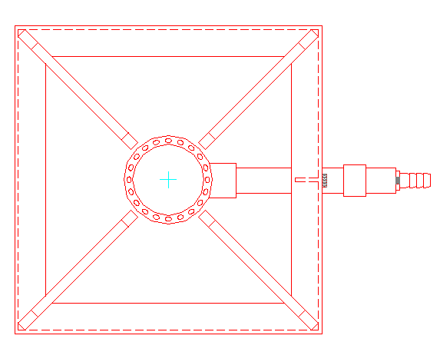
Biogas Stove

Slide 30
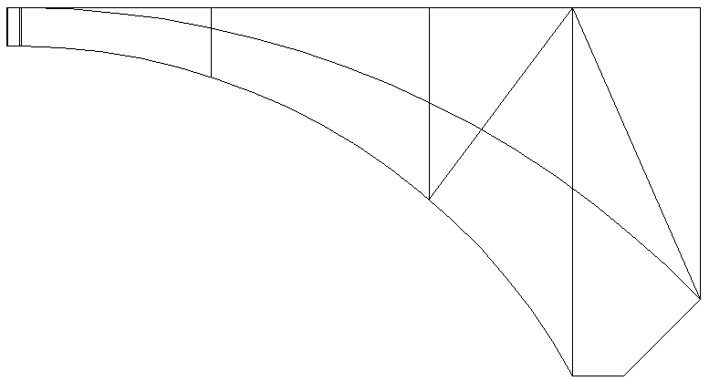
Dome Template

Slide 31
Biogas Injerra Stove

Slide 32
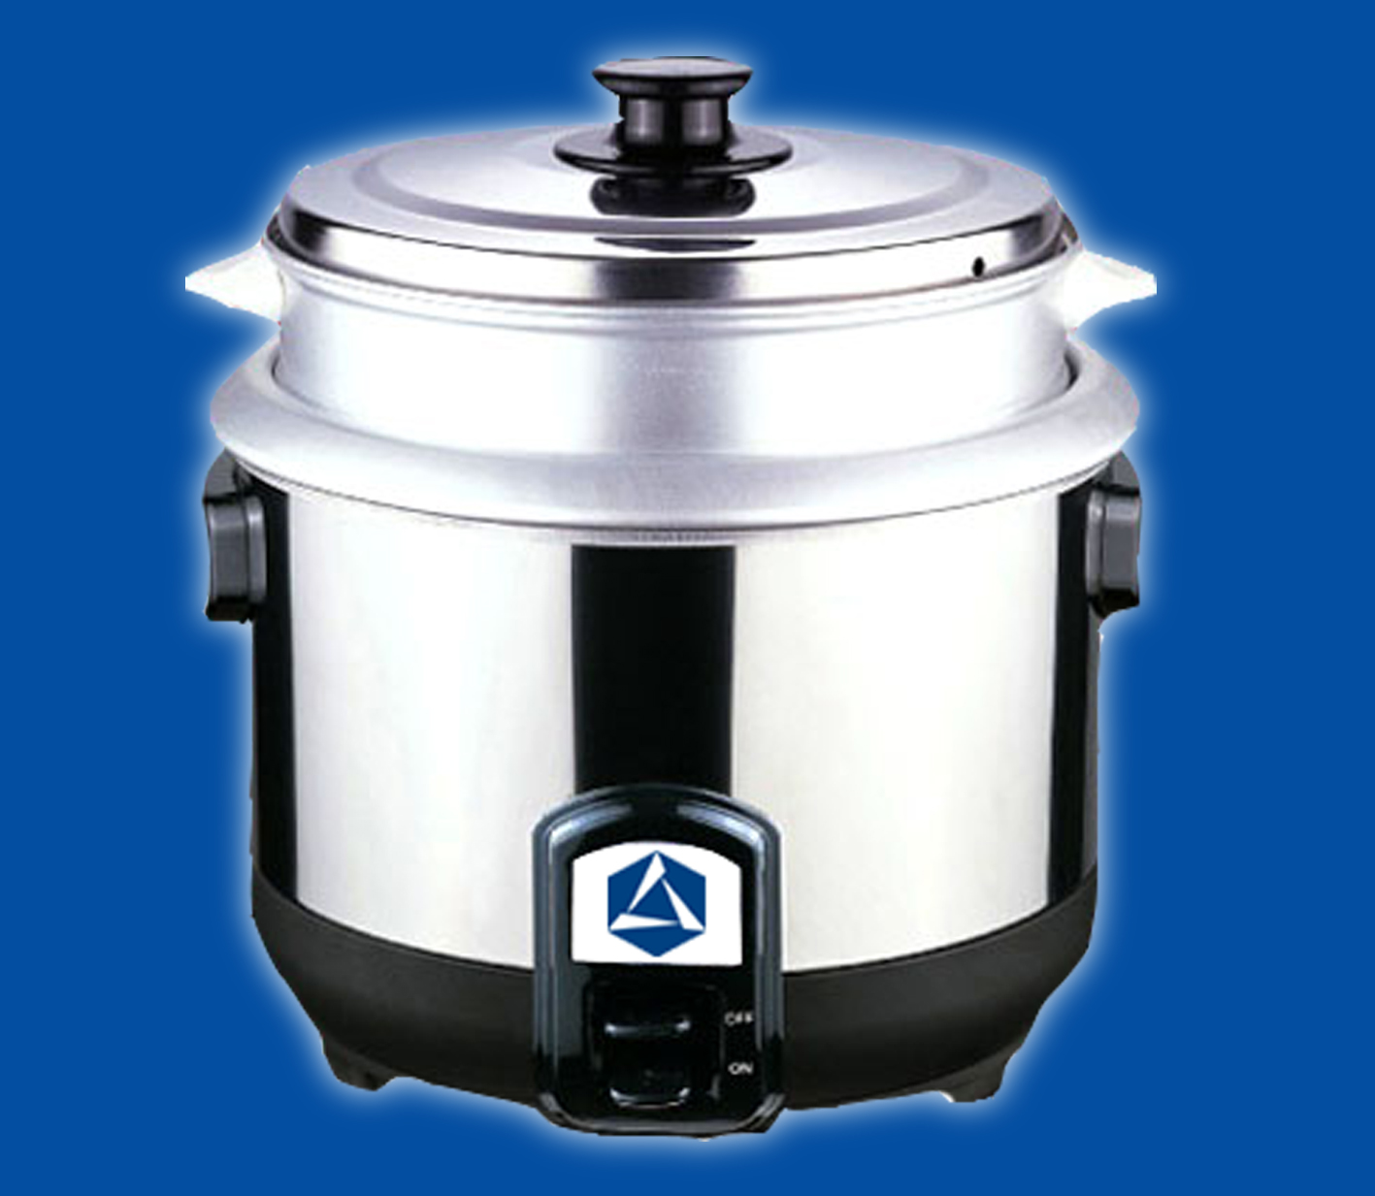
Biogas rice cooker (China)

Slide 33
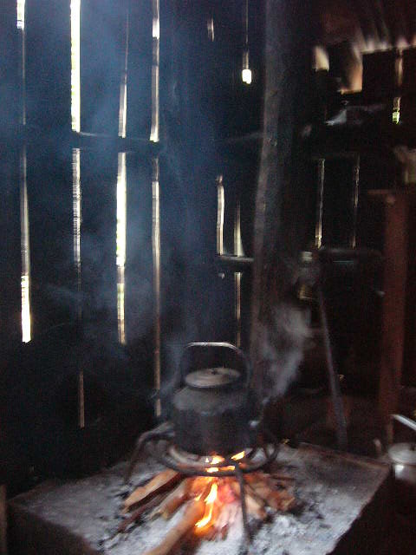
WHO: 1.6 mln people die each year of fumes

Slide 34
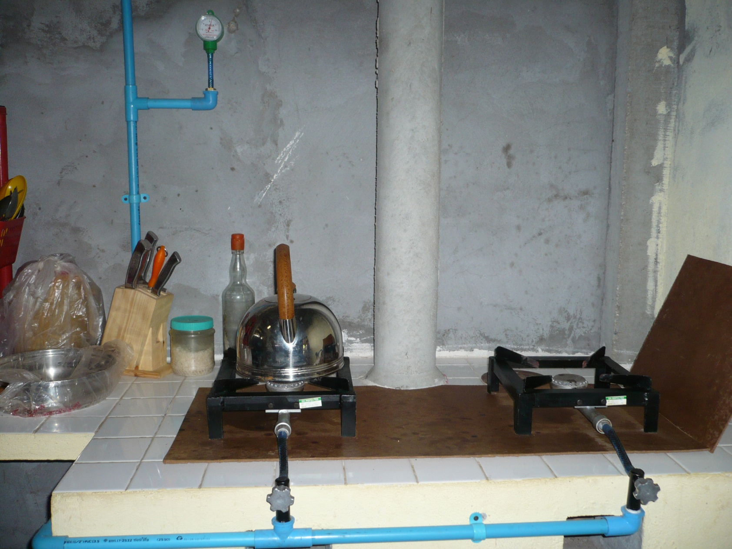
Improved kitchen

Slide 35
Fuel matrix
Fuel | Unit | Heat value kCal/Unit | Stove | Efficiency | Amount of biogas eq
Biogas | m3 | 5,200 | Gas stove | 60 | 1
Straw | Kg | 3,300 | Tripod stove | 11 | 8.60
Wood | Kg | 3,800 | Tripod stove | 16 | 5.00
Charcoal | Kg | 6,900 | Oven | 28 | 1.62
Kerosene | Litre | 9,100 | Oil stove | 45 | 0.76
LPG | m3 | 25,000* | LPG stove | 60 | 0.20
Electricity | kWh | 860 | Electric cooker | 70 | 5.18

Slide 36
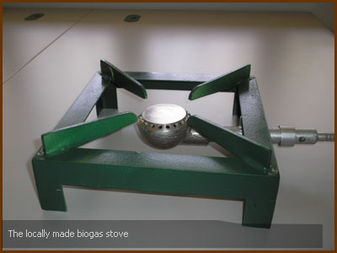

Slide 37
Current Developments
In cooperation with the African and Lao biogas programmes the NBP in Cambodia has made a R&D contract with a mechanical development agency with the following objectives
Improvement of the present design biogas stove manufactured in Cambodia;
Development of a complete package of documentation and special tools required for the manufacturing of the improved stove, and;
Training package development for vocational trainers and workshop technicians on the manufacturing of the stoves.

Slide 38
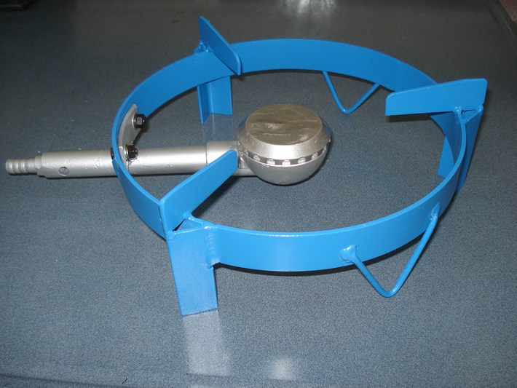
Lotus Biogas Stove

Slide 39
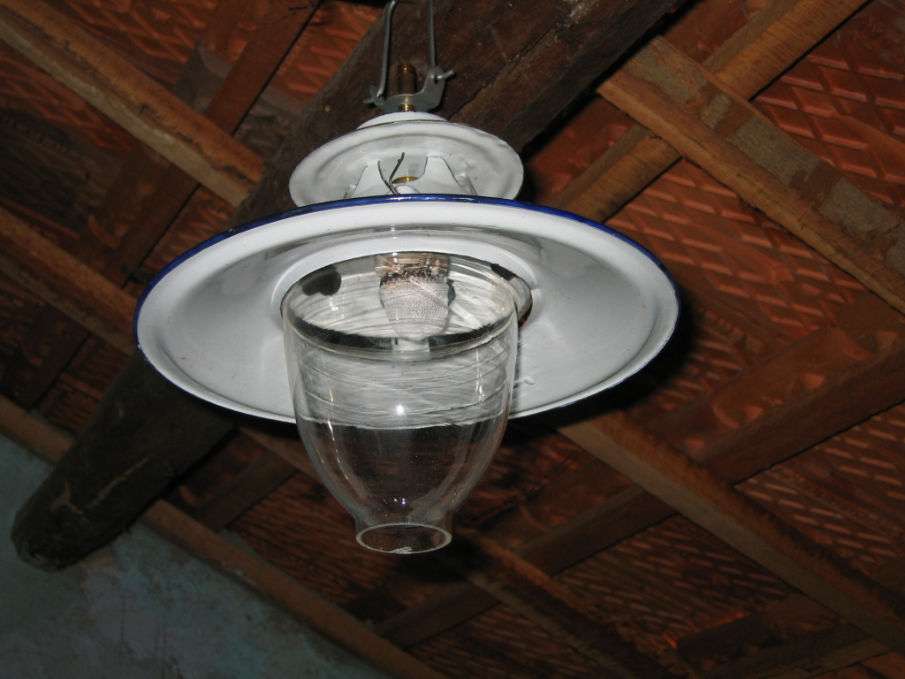
Applying biogas for light

Slide 40
Benefits of applying biogas: light
Capacity comparable with 60-75 W incandescent lamp
CONVENIENCE
Backup to unreliable electricity grid
Replacement for –costly- batteries, candles, kerosene, etc.
Gives light where is used to be dark
Low gas use, 80 – 100 liters/hour
SAFER
Reduces the risk of fire in the house when well positioned and care is take when the mantle needs to be replaced
HOWEVER
Poor efficiency of only 3% (Kerosene lamp 6%)
Very high temperature is needed to glow 1,000-1,500 C
Frequent change of mantle

Slide 41
Biogas lamps
Will fulfill a demand for good quality light
Difficult to be made by small scale workshops
Cheap large scale production in China and India
Need a good service infrastructure (regular need for spare-parts)
Need quality user training for operation and maintenance

Slide 42
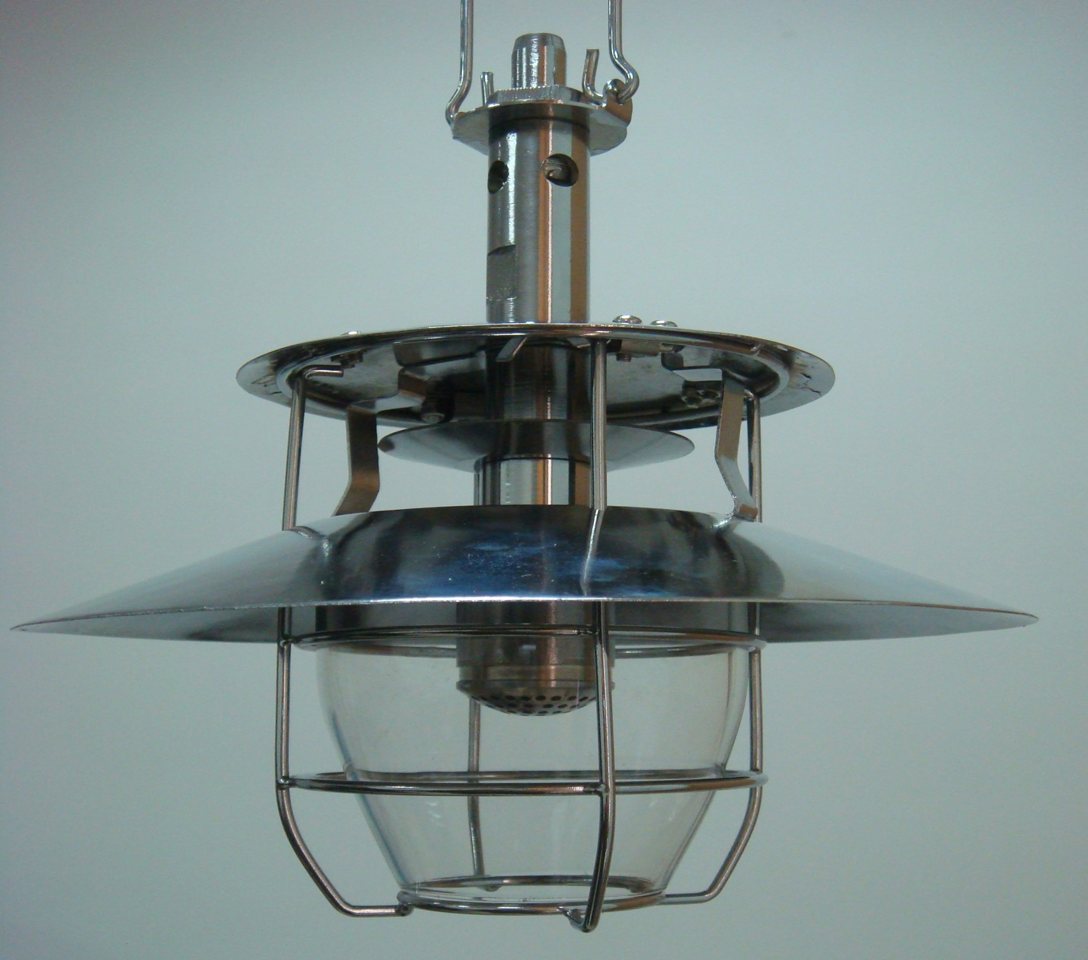

Slide 43
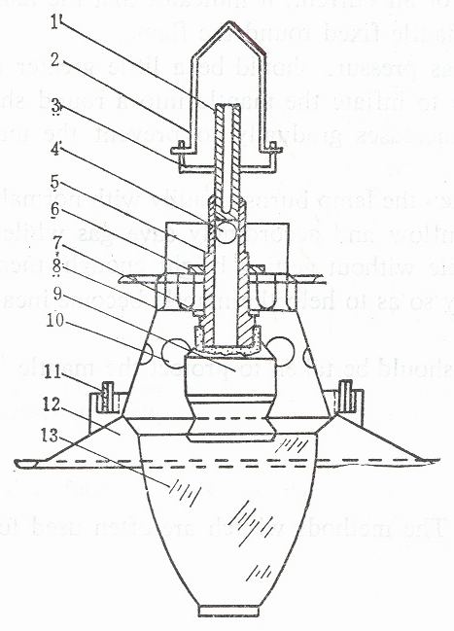
Lamp design China
Nozzle and injector
hanger
connecting piece
inlet for primary air
injector
nut
washer
upper cover
clay head
air vent
clip pin
reflector
glass cover

Slide 44
Lamp design India

Slide 45
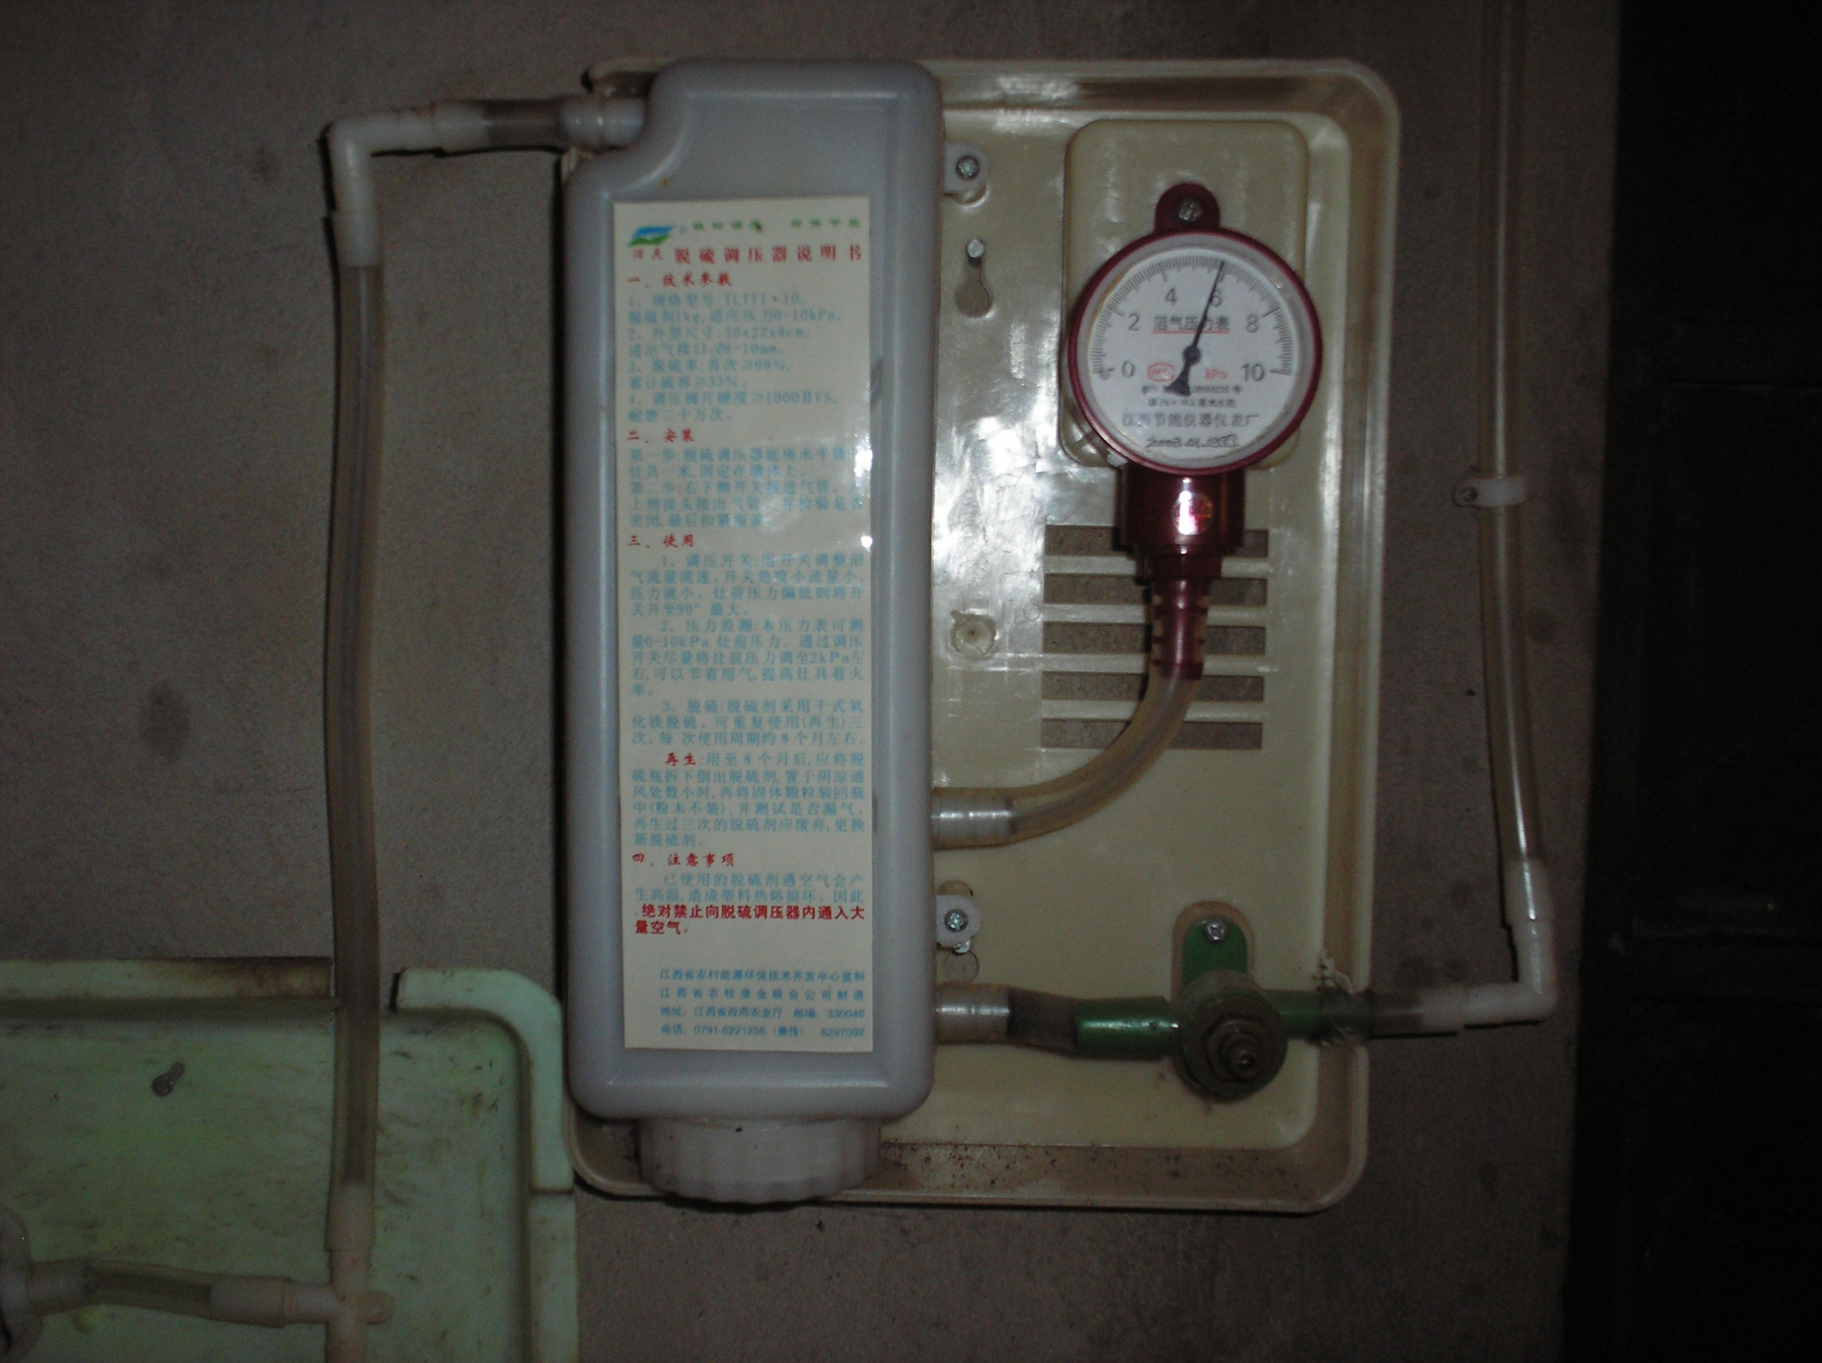

Slide 46
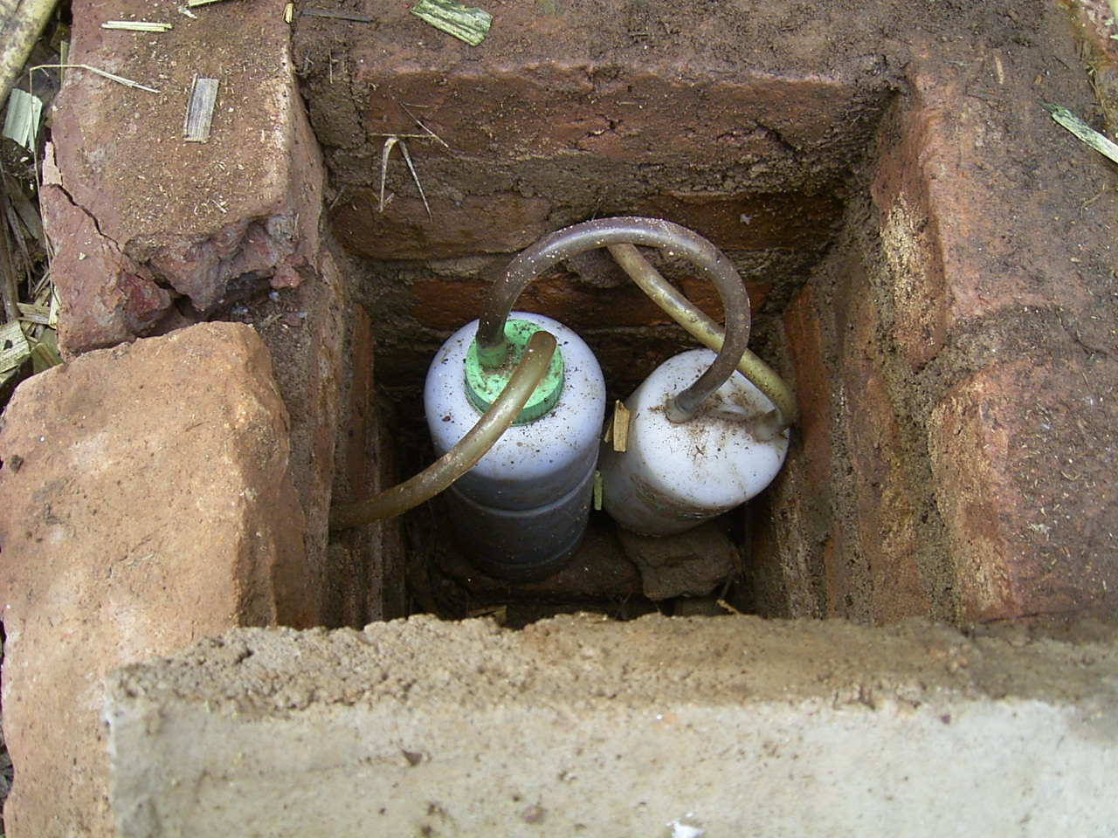

Slide 47
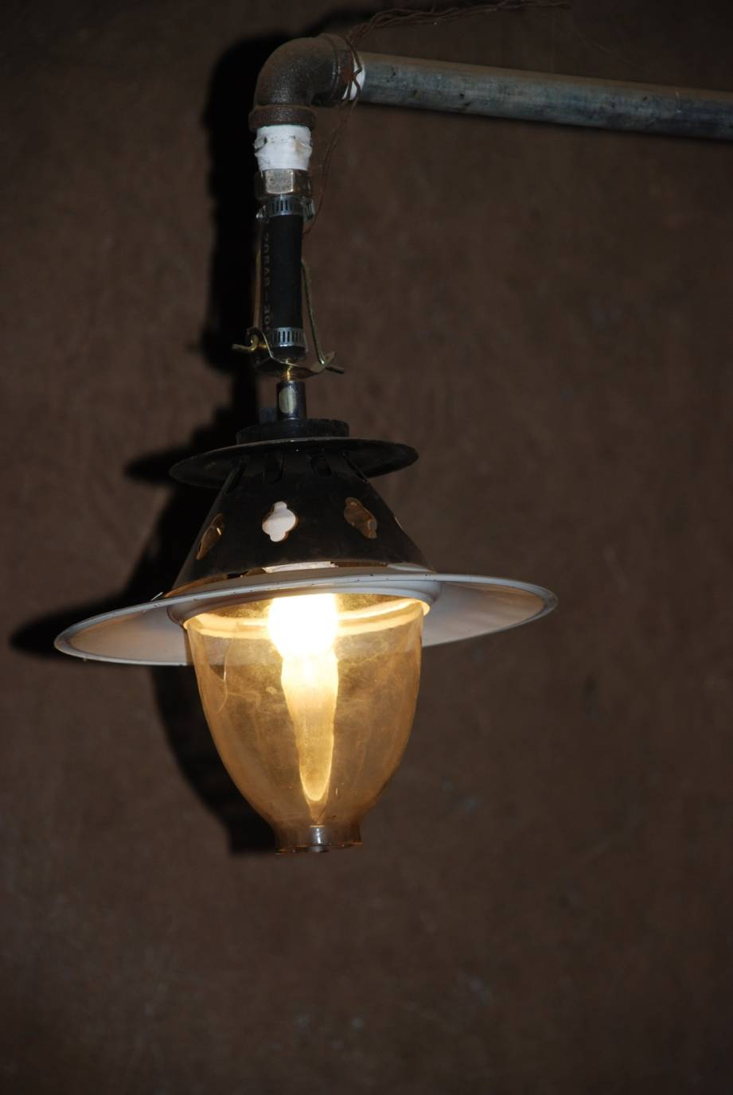
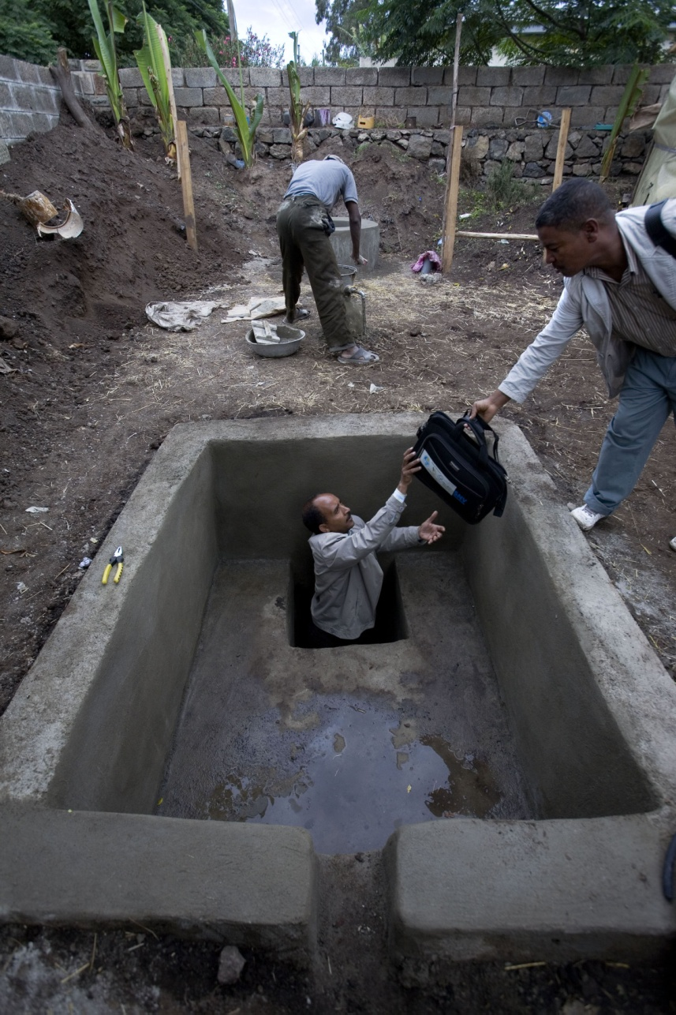
THANK YOU VERY MUCH!

